Slide 1
Graciano Mendoza Vice President of Administrative Services David Techaira Executive Director of Fiscal and Auxiliary Services September 3, 2024
FY 2024-25
Final Budget
and
Multi-Year
Projections
FY 2024-25 thru FY 2028-29

Slide 2
AGENDA
Final Budget Summary
2) Multi-Year Projections
3) Future Considerations, Recommendations and Reminders

Slide 3
1) FINAL BUDGET SUMMARY

Slide 4
CALIFORNIA STATE BUDGET HIGHLIGHTS
Multi-year budget deficits
$45 billion in 2024-25
$30 billion in 2025-26
Significant cuts to government operations, reductions to programs and pauses new investments.
Includes an across-the-board reduction to Chancellor’s Office operations by approximately 7.95%. Permanently eliminates 10,000 state positions that are currently vacant, beginning in 2025-26.
Includes no major core reductions to community college programs or services
Draws on reserves and operational savings to ensure fiscal stability

Slide 5
COMMUNITY COLLEGE SYSTEM HIGHLIGHTS
District Revenue Protections Continue: The 2022 Budget Act extended the revenue protections in a modified form beginning in 2025-26, with a district’s 2024-25 funding representing its new “floor.” Starting in 2025-26, districts will be funded at their SCFF generated amount that year or their "floor” (2024-25 funding amount), whichever is higher.
CA Community College Funding Increases: The enacted budget includes about $143 million in ongoing adjustments to the Student Centered Funding Formula (SCFF), of which $100 million is for 1.07% cost-of-living adjustments (COLA). Another $13 million is provided for the same COLA for selected categorical programs along with $28 million for 0.5% enrollment growth.
Withdraws $8.4 billion from the Proposition 98 Rainy Day Fund, but deposits $1.1 billion after 2024-25 to begin rebuilding a cushion

Slide 6
FY 2024-25 FINAL BUDGET
No General Unrestricted Fund (GUF) On-Going augmentations for Learning Sites, or PPA/Resource Requests
Utilizes OPEB Trust Funds
Achieves Budgetary Savings through Refinement of Budget Practice to More Closely Mirror Actual Usage

Slide 7
EXECUTIVE SUMMARY
General Fund Budget is balanced at $73.1M.
Includes proposed COLA revenue and revenue deficit factor of 3.11%
Salary and benefits account for 81% of total expenditures.
Estimated year-end Fund Balance (reserve) is 22% or $16.3M.
All identified requirements have been funded, including adjustments to employee benefits.
Step and column increases.
STRS rate remains at 19.10 percent (same as 2023-24).
PERS rate increase to 27.05 percent (up from 26.68%).
Worker’s compensation rate decrease to 1.7557% (down from 1.8685%)
Health and welfare benefits increase by an estimated 12.47%.
All District Funds are projected to have a positive balance at the end of 2024-25.

Slide 8
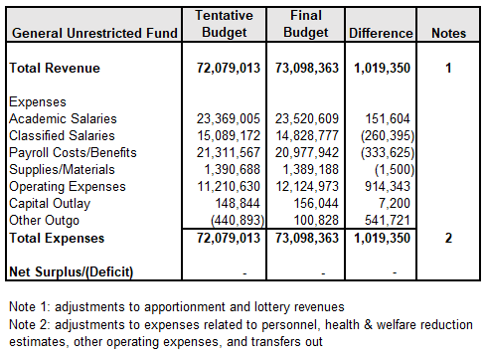
CHANGES FROM TENTATIVE BUDGET

Slide 9
PROPOSED GENERAL FUND EXPENDITURE BUDGET 2024-25

Slide 10
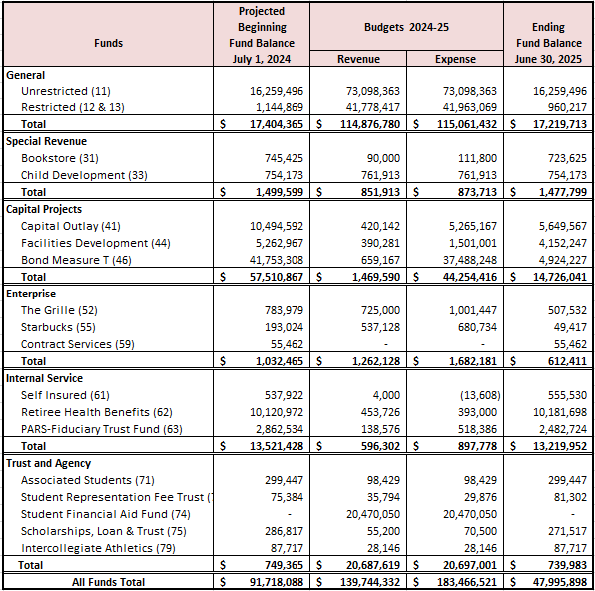
BUDGET SUMMARY BY FUND

Slide 11
2) MULTI-YEAR PROJECTIONS

Slide 12
REVENUE ASSUMPTIONS
FY 24-25 => 1.07 Percent Funded COLA (approx. => $713K)
FY 24-25 => Includes Deficit Factor of 3.11%
FY 25-26 thru FY 27-28 => 2.93%, 3.08% and 3.30%
(School Services of California Inc., as of May 21, 2024)
FY 24-25 thru FY 27-28 => 0.5% Growth

Slide 13
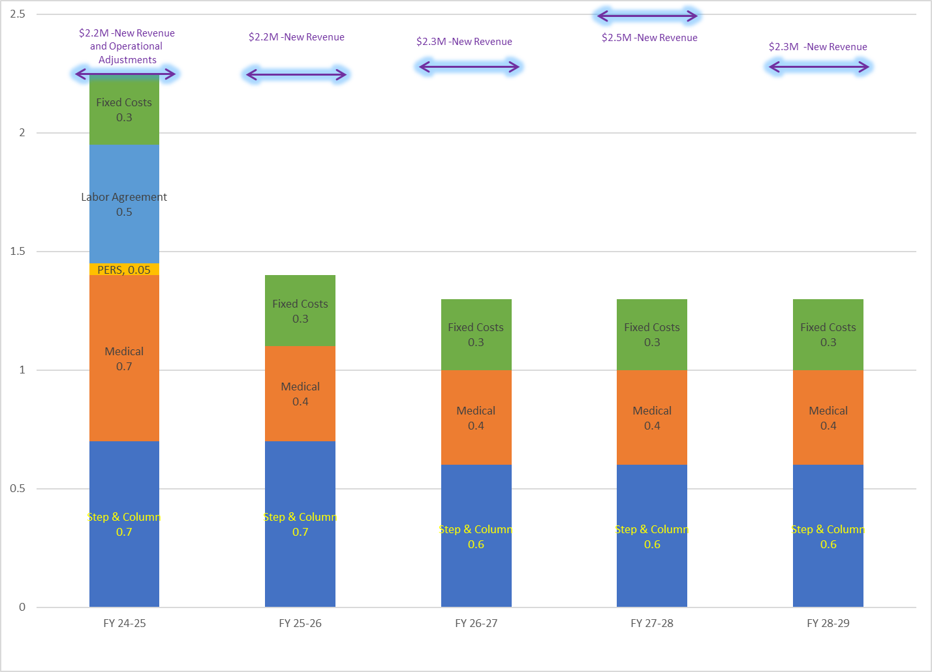
Multi-Year Projections for FY 2024-25 thru FY 2028-29

Slide 15
ENROLLMENT TRENDS

Slide 16
3) FUTURE CONSIDERATIONS, RECOMMENDATIONS and
REMINDERS

Slide 17
FUTURE CONSIDERATIONS
Vulnerable to State Economic Fluctuations
Escalating Compensation and Operating Expenses Requires Additional Annual Funding Just to Cover Existing Commitments
FY 24-25 Designates the End of “Hold Harmless”, Emphasizing Importance of Future Managed Enrollment Efforts
Limited Availability of Growth Funding will Require Careful Management of Enrollment
Deficit Factor
Other?

Slide 18
RECOMMENDATIONS AND REMINDERS
Recommendations:
Approve proposed Final Budget by September 15th.
Reminders:
Approval of the Final Budget authorizes spending for FY 2024-25.
The Final Budget is a projection of revenues and expenditures based on the adopted State Budget and adjusted according to the District’s own operations.

Slide 19
Thank you!

