Slide 1
Say Goodbye To The Binder!
Revisions to the Tenure Review Process
Fall 2019

Slide 2
Out With The Old, In With The New
The Tenure Review process is being streamlined and organized for efficiency!
Reports have been created to allow for clear and consistent input of information
The requirement of binders is being phased out
Timelines and expectations are being presented in a clear and concise manner for each member of the evaluation team

Slide 3
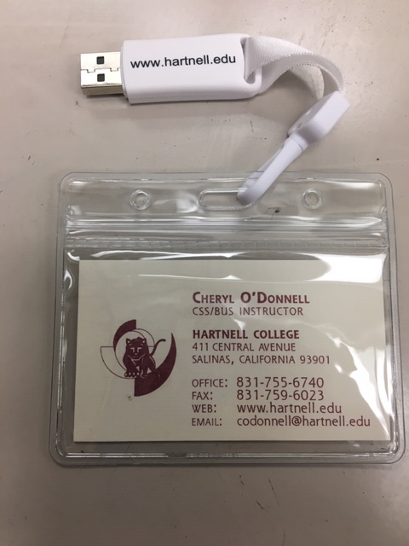
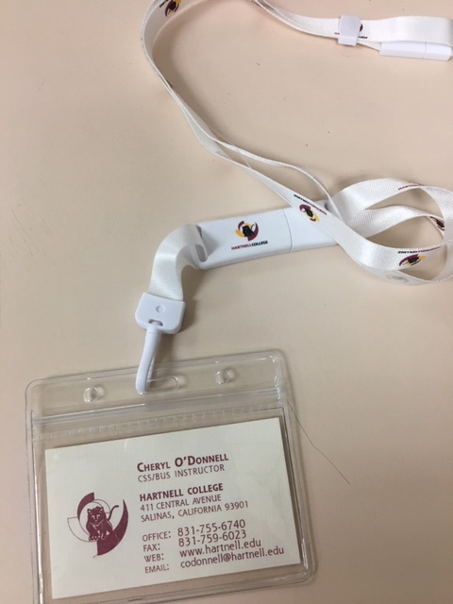
Moving Forward - Your New Binder

Slide 4
Structure Of Your Binder
A USB drive
Prior to distributing the USB drives, folders will be created for you
Report Templates Folder
Instructional Materials Folder
Evidence Folder

Slide 5
The Three Required Reports
These reports will be in a folder on the USB drive
Suggested Order of Completion
Professional Growth Report
College Related Activities Report
Self-Appraisal Report
This report contains a section for your goals
Avoid Redundancy
Notes:
Avoid redundancy

Slide 6
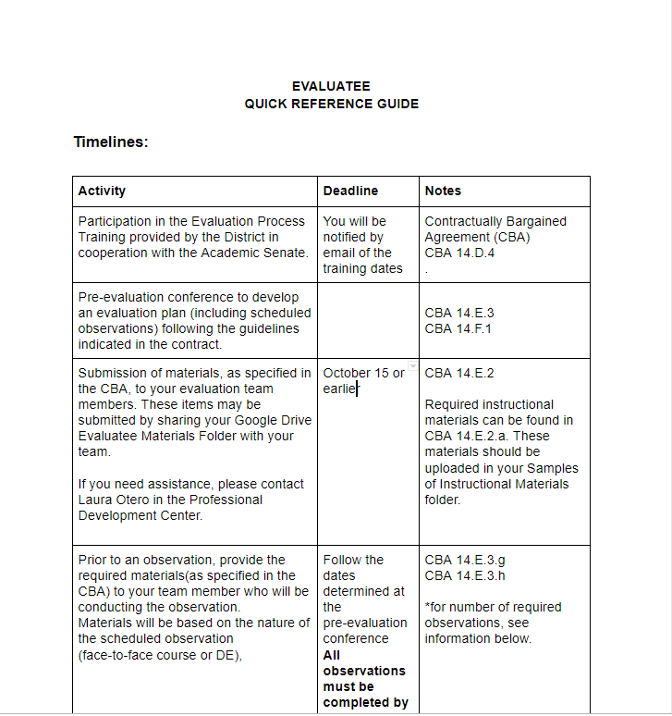
Quick Reference Guides
A summary designed to provide you with information from the contract presented in an organized manner!
You will find this on your USB drive as well as in the Senate Canvas Shell

Slide 7
How To Receive Your “New Binder”
USB drives have been ordered!
You will be notified by email or a Canvas message once the USBs are ready
Pick them up at the Dean’s office (?)

Slide 8
Submission Of Your Digital Binder
Submission of evaluation materials must be done no later than October 15!
Submit your USB drive to your dean’s office
It is highly recommended that you make a back-up copy of your files!
Need help? Contact Laura Otero or Cheryl O’Donnell
lotero@hartnell.edu 755-6776
codonnell@hartnell.edu 755-6740

Slide 9
Questions??
If you have any questions regarding the new process, please reach out to your Senate President or 1st Vice President!
Both were involved in the revisions made
Lisa Storm, Senate President
lstorm@hartnell.edu
Cheryl O’Donnell, Senate 1st Vice President
codonnell@hartnell.edu

