Slide 1
Business Office Training
July 19, 2019

Slide 2
VISION AND MISSION STATEMENTS
Vision
Hartnell College students will be prepared to contribute as leaders to the intellectual, social, cultural, and economic vitality of our communities and the world.
Mission
Focusing on the education and workforce development needs of communities in the Salinas Valley, Hartnell College strengthens communities by providing educational opportunities for students to reach career and/or academic goals (associate degrees, certificates of achievement, transfer to four-year institutions) in an environment committed to student learning, achievement, and success.

Slide 3
Topics covered
Introductions
Purchasing
Contract for Services
Accounts Payable
Travel
Expenditure and Budget Transfers
Timesheet Reminder
Chart of Accounts
Useful Colleague Screens
2018-19 year-end reminders

Slide 4
INTRODUCTIONS
Document Type | Contact Person
Accounts Receivable/Campus Credit Cards | Mary (Lucy) Trafton
Accounts Payable | Karen Martinez
Payroll | Abel Del Real & Dora Sanchez
Budget Revisions/Transfers – Non-grants Budget Revisions/Transfers - Grants | Suzie Payne & Paul Luciano David Techaira, Elizabeth Flores, & Jennifer Santana
Travel and Conference | Mary (Lucy) Trafton; Julie Silveira
Cash Receipts | Tina Summers & Blanca Garcia Iniguez
Grants | David Techaira, Elizabeth Flores, & Jennifer Santana
Expenditure Transfers – Non-grants | Suzie Payne & Paul Luciano
Expenditure Transfers – Grants | David Techaira, Elizabeth Flores, & Jennifer Santana
Purchasing/Purchase Orders/Requisitions | Joanne Ritter
Petty Cash Reimbursements | Suzie Payne, Dora Sanchez, & David Techaira

Slide 5
Purchasing
Purchase Requisitions & Orders
Signature Guidelines
Vendor Info. Form (new vendors)
Bidding Procedures Matrix
Blanket Purchase Orders
Regular (Mercury Commerce) POs
Receiving

Slide 6
Purchase requisitions & orders
Purchase orders/requisitions are required for all of the following:
Tangible goods
Food/Catering
Services
*Purchase order/requisitions must be created before placing orders for goods and services*

Slide 7
SIGNATURE GUIDELINES
For a Request Total of any dollar amount: Dean/Program Director
2. For a Request Total at or above $5,000:
Vice President
3. For a Request Total at or above $10,000: President / Superintendent
*See Signature Guidelines for Requests

Slide 8
Vendor info form - New vendors
To do business with any vendor, that vendor must be set up in both the Colleague and Mercury Commerce databases.
Use “VENI” in Colleague to determine if the vendor is in our databases, or contact Purchasing.
If the vendor does not exist, please have vendor complete the Vendor Information Form.
Initiate new vendor process two weeks prior to submitting purchase request or check request.

Slide 9
Bidding procedures matrix
The Bidding Procedures Matrix outlines the action needed for purchases at various dollar levels.
Documentation of the required bids must be included with the purchase request, whether through Mercury Commerce or paper format.

Slide 10
BLANKET PURCHASE ORDERS
Blanket POs are for multiple payments to the same vendor throughout the fiscal year for a single project/service, or for undefinable goods purchases.
An example of a BPO requirement is an on-going service contract.
Blanket POs are initiated using a Purchase Requisition form (not through Mercury Commerce).
Approval logic is the same as Mercury Commerce; approval signatures must be obtained on the Requisition Form.
Purchase Requisition forms may be obtained from the Business Office.

Slide 11
regular (mercury commerce) PURCHASE ORDERS
Regular Purchase Orders are for defined purchases and valid for one use only. Product, quantities, and unit pricing are known, and are listed as line items on the PO when the request is converted.
Requests for Regular Purchase Orders are processed through Mercury Commerce.
Refer to guidelines on Check Request vs. Purchase Requisition

Slide 12
receiving
Receiving needs to occur before an invoice can be paid. This is done in Mercury Commerce and should be performed as soon as items are delivered.
This task is primarily done by the warehouse; however, not everything is handled by the warehouse. Services, and any goods that bypass the warehouse (such as deliveries directly to Alisal or King City) need to be received by the department/requester.

Slide 13
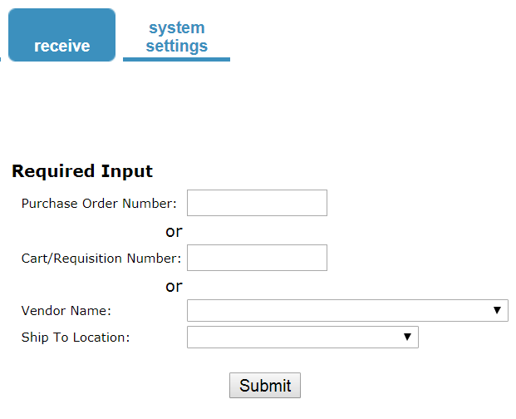
Receiving in mercury commerce

Slide 14
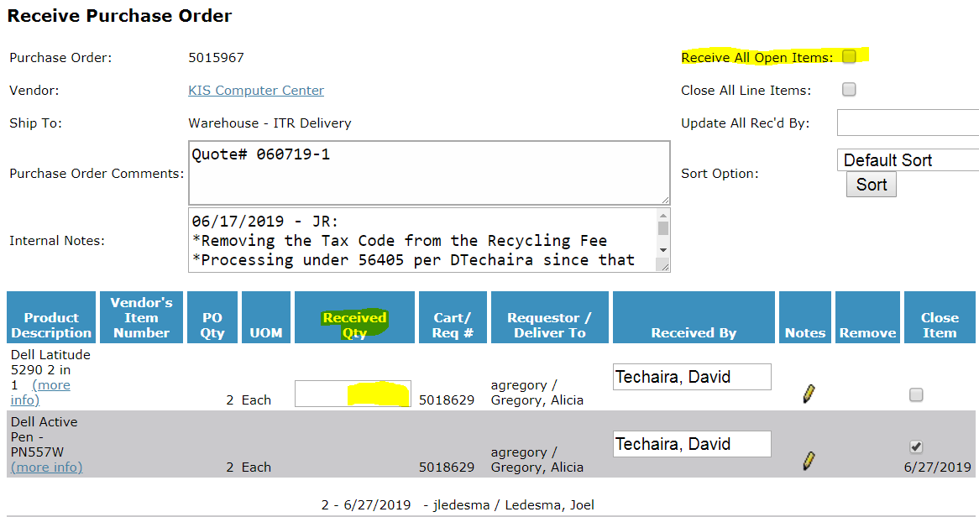
Receiving in mercury commerce

Slide 15
CONTRACT FOR SERVICES
The Agreement / Contract Template can be found on the Business Office web page
The agreement/contract must be accompanied by a Tracking Sheet Template
Plan ahead – the approval process takes time. All agreements/contracts must be signed by the President of the college BEFORE services commence.
If the contract expense exceeds the limit on the Bidding Procedures Matrix, the Board of Trustees must approve the contract before the President signs and BEFORE services commence.

Slide 16
Accounts payable
All vendors need to be directed to send invoices directly to accountspayable@hartnell.edu.
If you receive invoices in your department, please forward to the Business Office as soon as possible.

Slide 17
Check requests
A Check Request form should be used for the following:
Dues
Subscriptions
Reimbursements
Conference Registrations
Guest Speakers
Student Stipends
*Always attach proper support documentation to check requests*

Slide 18
Accounts payable reminders
1-2 week turnaround for all check requests.
Check your budget balances! Requests with insufficient funds will be returned to the department via campus mail.
*Use Colleague screen “ACBL” for account snapshot.
Reimbursements are an exception to the purchasing policy and will be carefully reviewed by the Controller and Accounting Manager.
Do not pay out of pocket; reimbursements are not guaranteed. Use purchase orders.
You will receive an email when your personal reimbursement check is ready to be picked up at the Cashiers Office. After 5 business days checks will be mailed.

Slide 19
Accounts payable reminders
Student stipends must have a Non-Service Stipend Contract Agreement completed and a student roster attached to the Check Request form (include ID#s, names, addresses, amount to be paid).
Do not make purchases from Follett without a purchase order.
Provide all invoices and original receipts to the Business Office. Reference purchase order number on the document.
Invoices must be signed by the budget or program manager.
All food purchases must have a completed 5 W’s form.

Slide 20
Amazon, home depot, raley’s, and smart & final purchases
For Amazon purchases, provide a signed copy of the order confirmation and reference purchase order number on the document.
All orders must be sent to Hartnell College. Do not ship to personal address.
For Home Depot, Raley’s, and Smart & Final purchases, provide a signed copy of the receipt(s) and reference purchase order number.
Signed receipts should be provided the day of purchase, or as soon as possible.

Slide 21
TRAVEL Authorization
All conference and travel expenses should be pre-approved by appropriate administrators 45 days in advance of travel dates.
Use a Travel Authorization form to propose a travel or conference expenditure. Attach all supporting documentation (Mapquest mileage, airfare, logding, other travel info.).
The approved Travel Authorization form is forwarded to the Business Office to assign a Travel Authorization (TA) number.
The TA number is needed to book travel through Concur.
Prepayment of some travel expenses (i.e., hotel reservations, airfare) can be charged to the Hartnell credit card upon receipt of approved Travel Authorization and Credit Card Payment Request forms.

Slide 22
Travel reimbursement
Business Office sends the traveler a “Travel Expense Claim Form.”
Traveler must save all original receipts associated with the conference/travel – college does not reimburse on a “flat rate” per diem.
Fill out “Travel Expense Claim Form,” attach original ITEMIZED receipts (no credit card summary slips), and obtain administrative signature(s) on the form.
Send completed “Travel Expense Claim Form” to the Business Office for payment processing.

Slide 23
Travel reminders
Out of state travel must be pre-approved by the Superintendent/President.
Some fund sources (Chancellor’s Office Grants) require travel pre-approval from the Chancellor’s Office.
Refer to Travel Information and Instructions.

Slide 24
EXPENDITURE TRANSFERS
Expenditure transfers are initiated when an expense (not budget) needs to be transferred from one account to another, typically due to an error, reallocation, or to pay internal departments (e.g. Food Service invoices).
Expenditure Transfer forms must be supported by a detailed budget status report (“GLBS” in Colleague) showing where the expense was initially posted.
For Food Service transfers, the invoice and a 5 W’s form needs to be attached to the Expenditure Transfer Request.

Slide 25
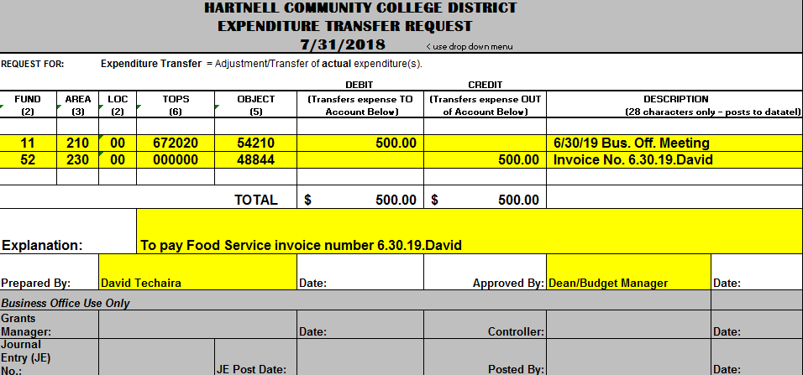
EXPENDITURE TRANSFERs
Example: Paying Food Services Invoice

Slide 26
BUDGET TRANSFERs
Budget Transfers are initiated when additional funds are needed in one or more general ledger accounts, typically due to a change in activity or program need.
These transfers move budget from one account to another, so you must identify the appropriate general ledger accounts to take from and add to.
All Budget Transfer forms must be supported by a detailed budget status report (“GLBS” in Colleague) showing where the budget is being transferred out of.
You can create accounts not currently in your budget if needed.

Slide 27
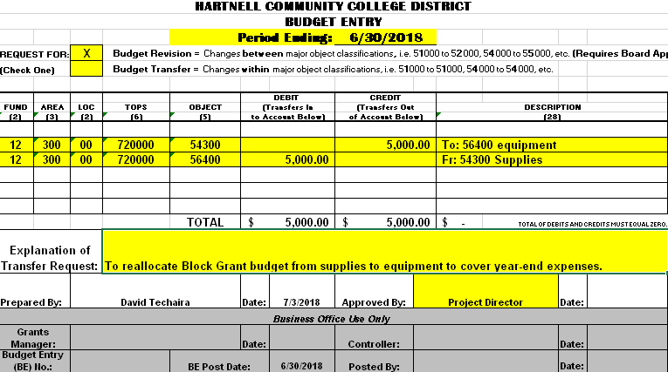
BUDGET TRANSFERs
Example: Reallocating budget from supplies to equipment

Slide 28
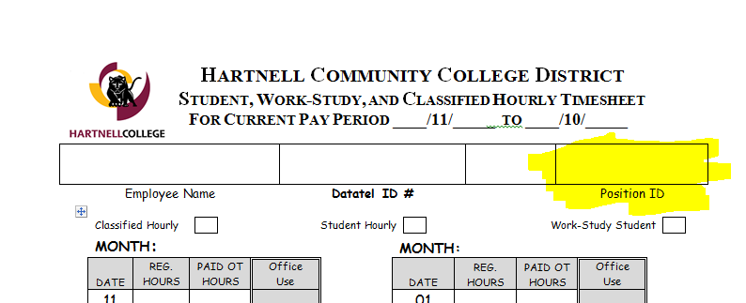
Timesheet reminders
Time & Effort forms must be completed for all federal grant employees.
Make sure the correct “Position ID” is used on timesheets.

Slide 29
Chart of accounts
Fund – Area – Location – TOP – Object
11-350-01-095200-54300
Fund “11” = General Fund
Area “350” = Occupational Education
Location “01” = Alisal Campus
TOP “095200” = Construction Technology
Object “54300” = Supplies and Materials
Chart of Accounts
http://www.hartnell.edu/sites/default/files/u88/chart_of_accounts_list.pdf

Slide 30
OBJECT CODES (Common Expense Codes)
54 Supplies & Materials:
54210 = Food purchases
54300 = Supplies & Materials
55 Other Operating Exp. & Svs.:
55100 = Personal svc. contracts
55105 = Contract services
55125 = Training & seminars
55200 = Travel & conference
55240 = Field trips
55300 = Memberships
55309 = Subscriptions
55635 = Printing services - vendor
55650 = Maintenance agreements
55830 = Advertising expense
56 Capital Outlay:
56300 = Library books
56341 = Online database services
56402 = Capital software
56400 = Equipment $200-$4,999
56405 = Equipment $5,000 & up
57 Other Outgo:
57500 = Student FA payment
57510 = Student internship
57350 = Indirect costs
57552 = Student travel
57600 = Other payments to/for students

Slide 31
USEFUL COLLEAGUE SCREENS
Budget Reports:
GLBS (Detailed Budget Status Report)
GLBR (Year-to-date Budget Summary Report w/ Purchase Orders)
Inquiry Screens:
ACBL – GL Account Balance Inquiry
VENI - Vendor Activity Inquiry
PINQ - Purchase Order Inquiry
BINQ – Blanket PO Inquiry
Purchase Order Report:
PREG – Purchase Order Register

Slide 32
BUDGET REPORTS – DETAIL (GLBS)
Instructions on how to run detailed budget status reports (GLBS in Colleague):
https://www.hartnell.edu/about/administrative-services/glbs_instructions.pdf

Slide 33
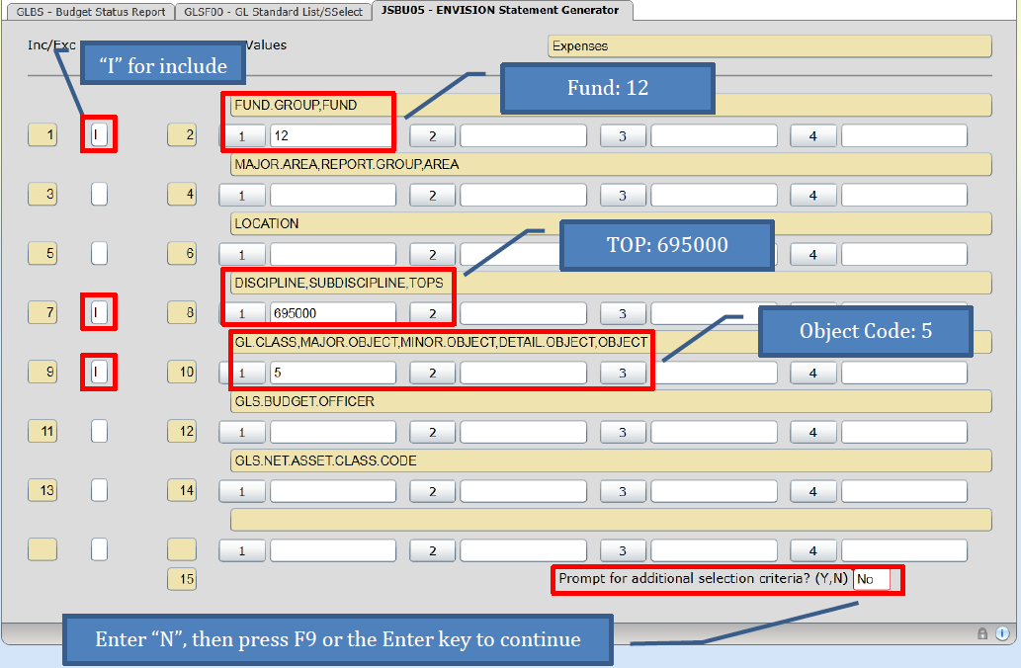
BUDGET REPORTS (INPUT GL ACCOUNT NUMBER COMPONENTS)

Slide 34
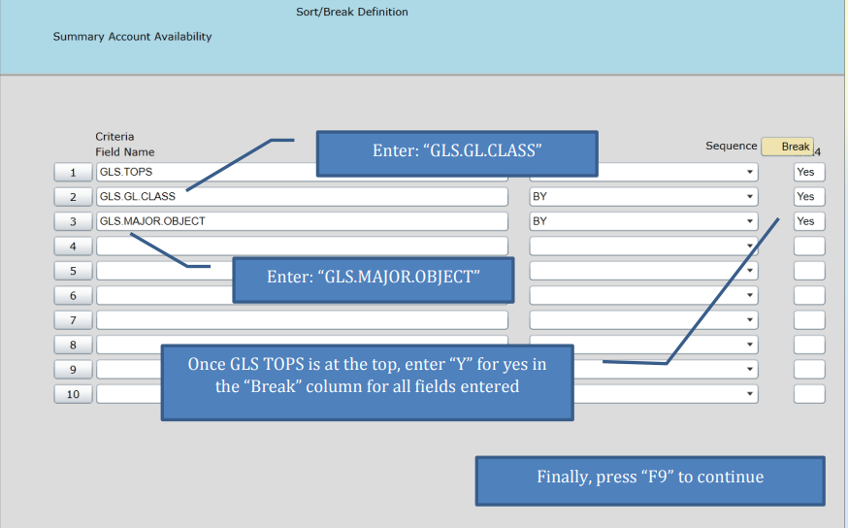
SORTING REPORT BY ACCOUNT COMPONENT

Slide 35
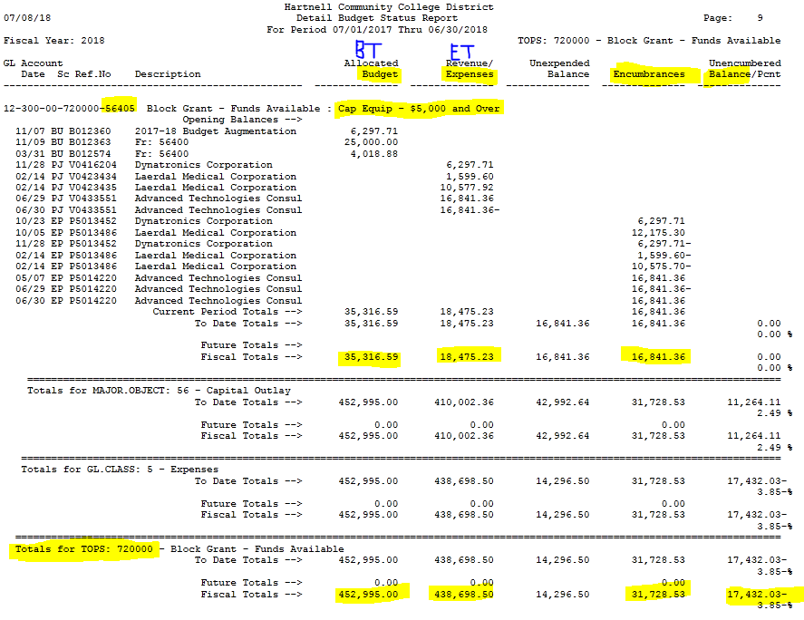
DETAIL REPORT (GLBS) EXAMPLE

Slide 36
BUDGET REPORTS – SUMMARY (GLBR)
Instructions on how to run a year-to-date budget summary report with encumbrances (GLBR in Colleague):
https://www.hartnell.edu/sites/default/files/u88/glbr_instructions.pdf

Slide 37
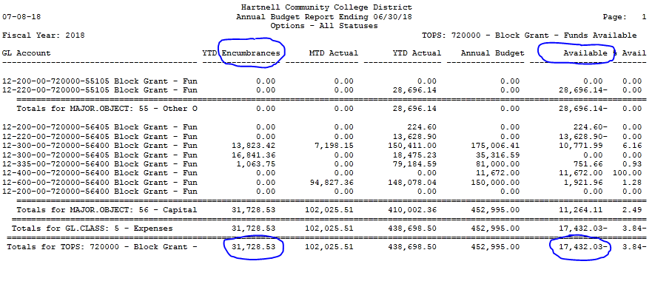
SUMMARY REPORT (GLBR) EXAMPLE

Slide 38
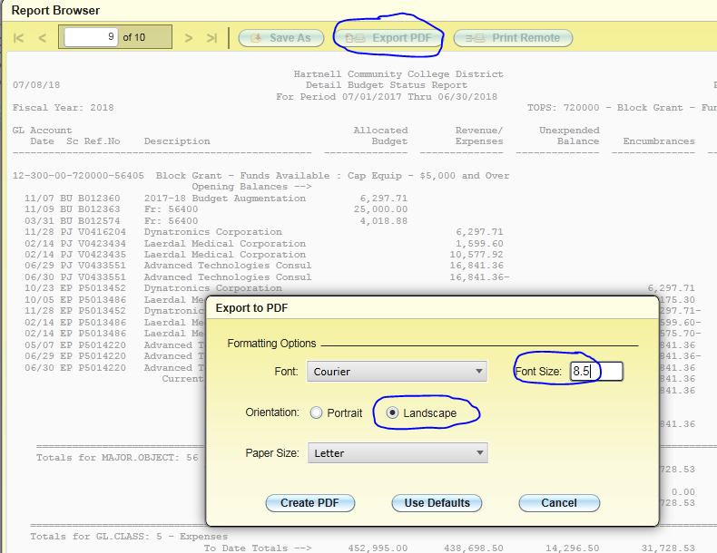
PRINTING BUDGET REPORTS

Slide 39
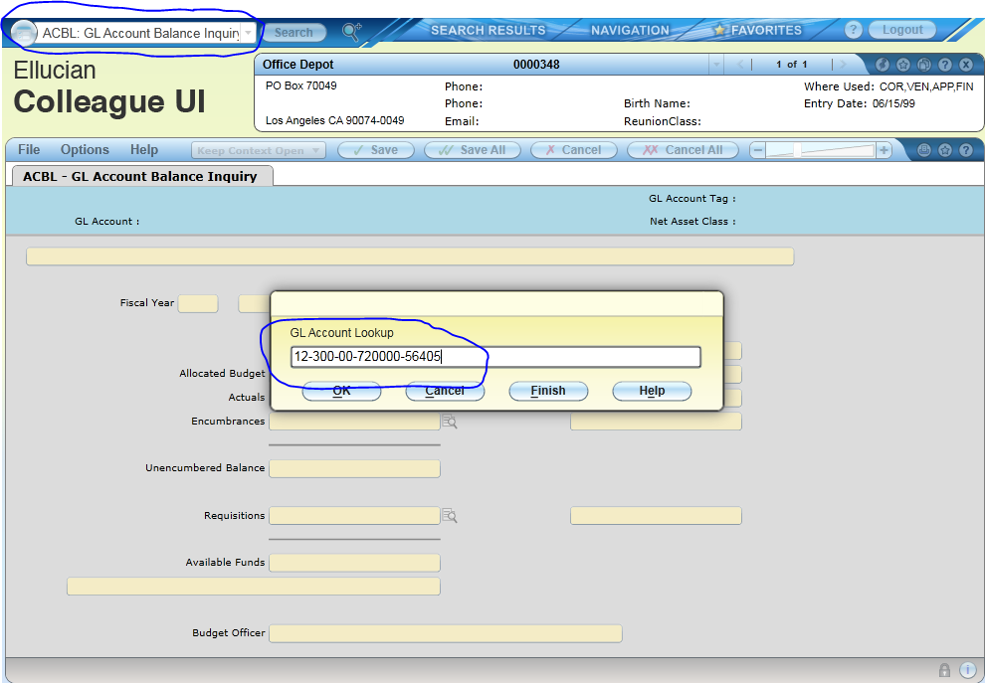
ACCOUNT BALANCE INQUIRY (ACBL)

Slide 40
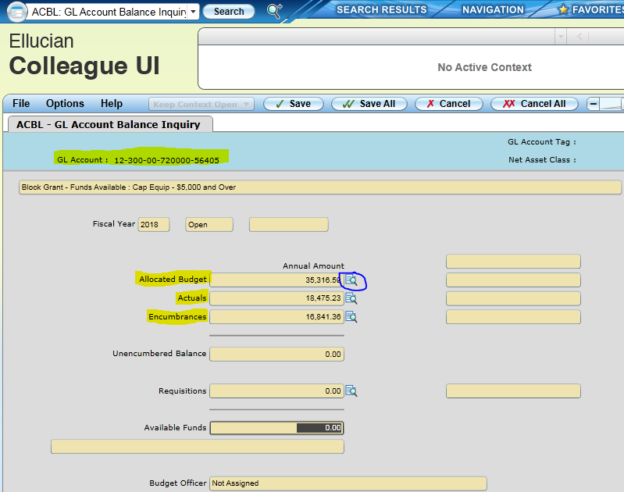
ACCOUNT BALANCE INQUIRY (ACBL)

Slide 41
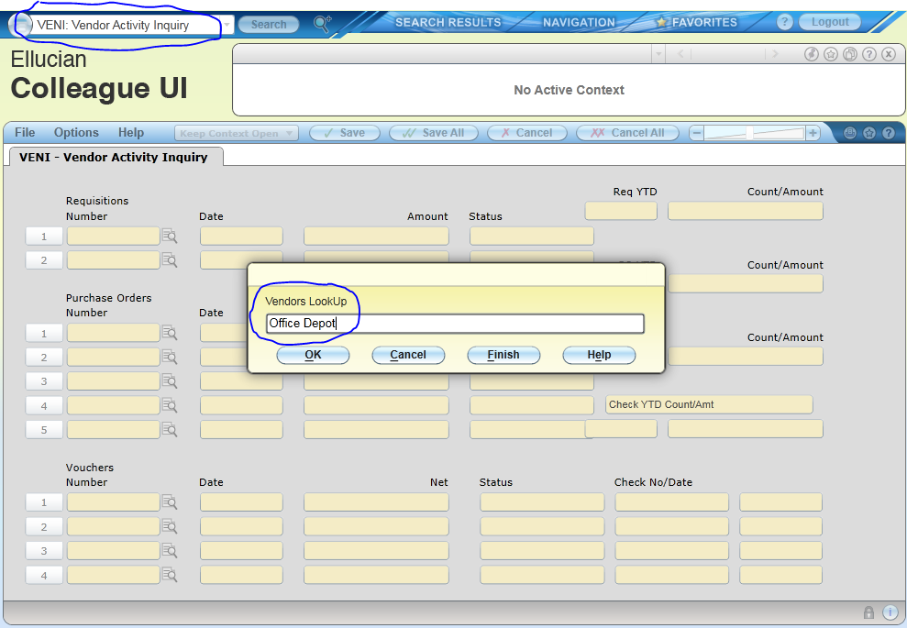
Vendor Inquiry (VENI)

Slide 42
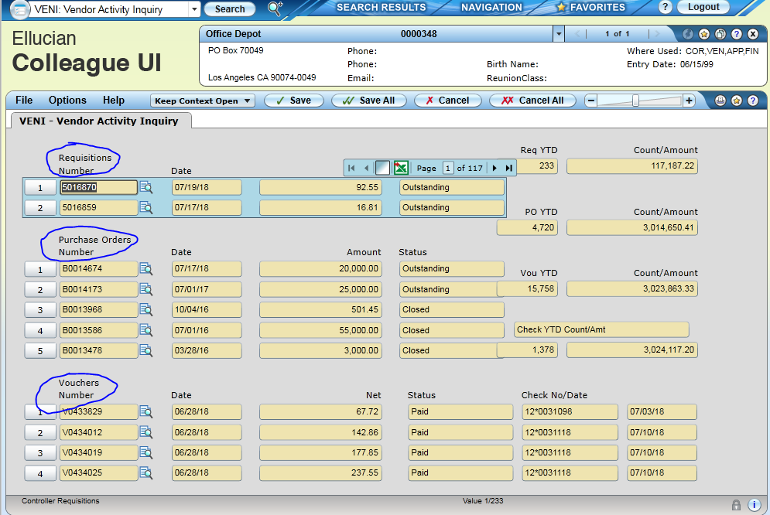
Vendor Inquiry (VENI)
This screen displays the current Requisitions (Mercury Commerce), Purchase Orders (Blanket POs & Regular POs), and Vouchers (Payments) by number. Clicking the blue icons below will provide more detail

Slide 43
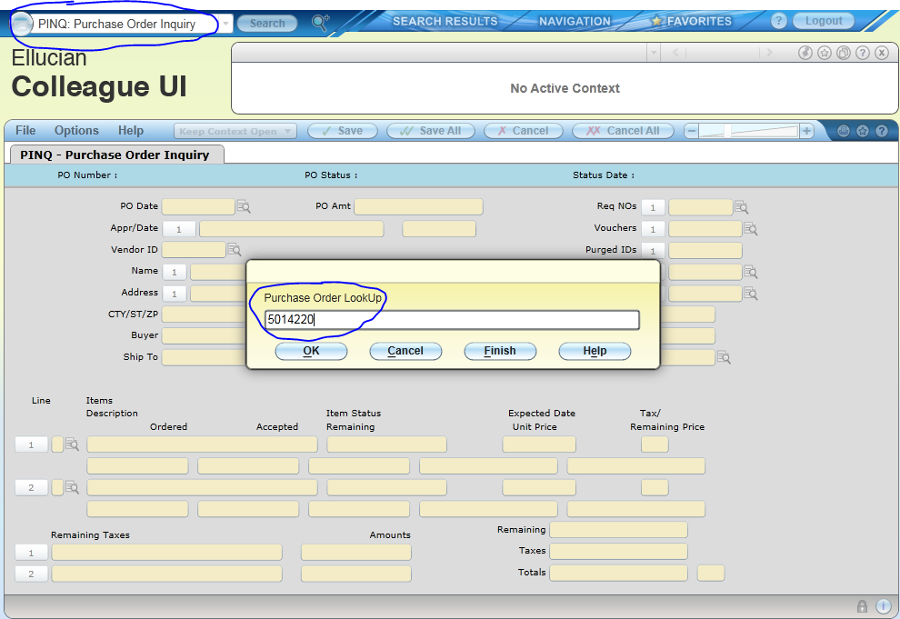
PURCHASE ORDER INQUIRY (PINQ)

Slide 44
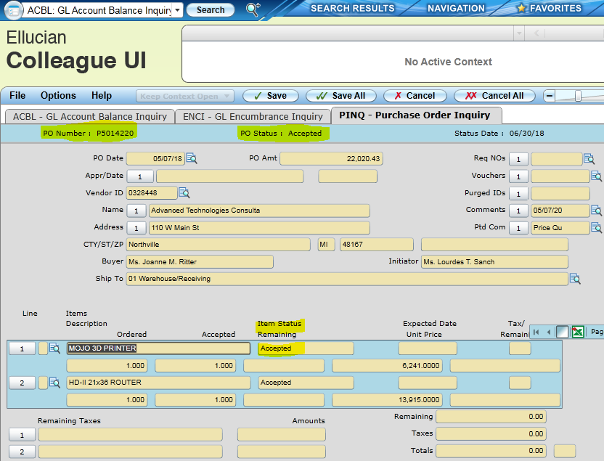
PURCHASE ORDER INQUIRY (PINQ)

Slide 45
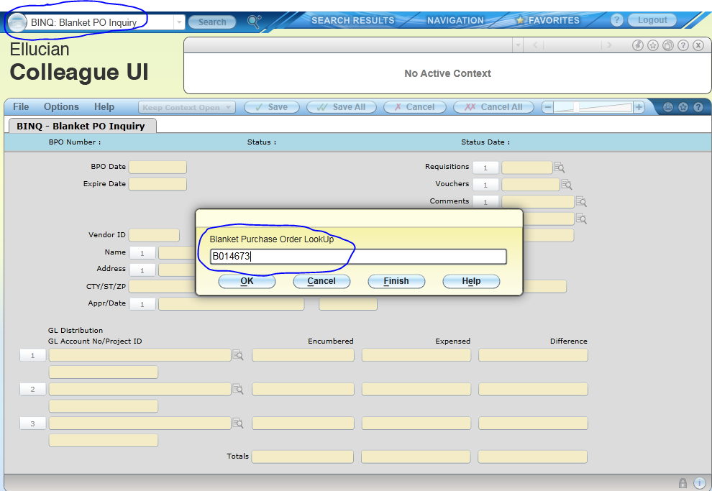
BLANKET PURCHASE ORDER INQUIRY (BINQ)

Slide 46
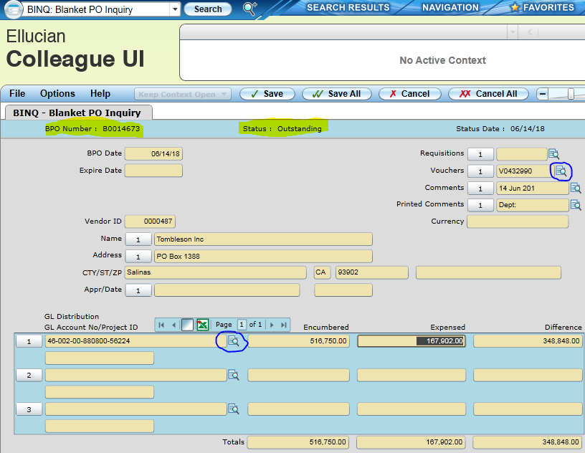
BLANKET PURCHASE ORDER INQUIRY (BINQ)

Slide 47
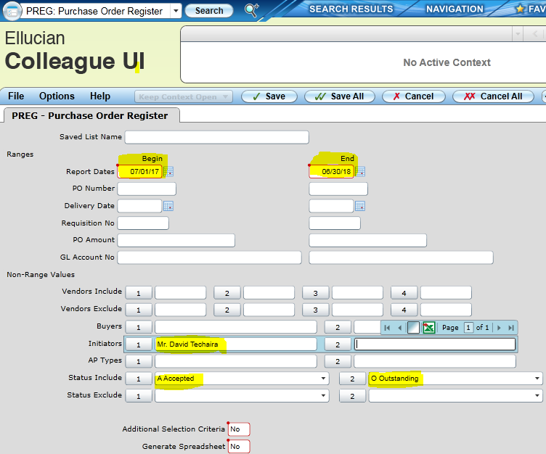
PURCHASE ORDER REGISTER (PREG)

Slide 48
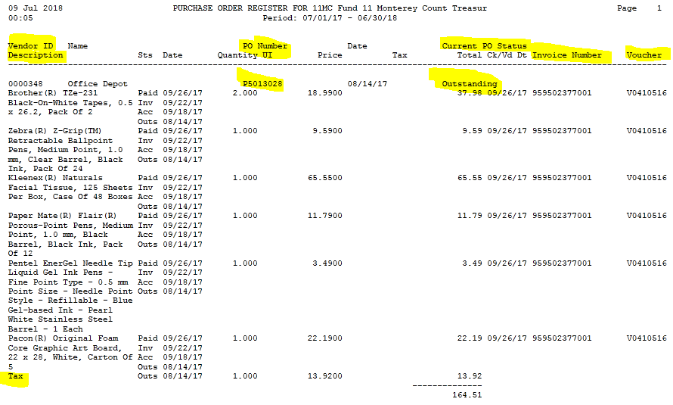
PREG REPORT EXAMPLE

Slide 49
2018-19 YEAR-END REMINDERS
Invoices, receipts, travel claims, check requests were due Wednesday, 7/10/19
Expenditure and Budget Transfers were due Friday, 7/12/19
Time & Effort Certifications for federal grant employees were due Friday, 7/12/19
Year-end payroll for OT, hourly staff, students, faculty SPAs – posted Wednesday, 7/17/19

Slide 50
Business office website
For more information about campus business processes, go to:
http://www.hartnell.edu/business-office

Slide 51
QUESTIONS?
THANK YOU!

